Slide 1

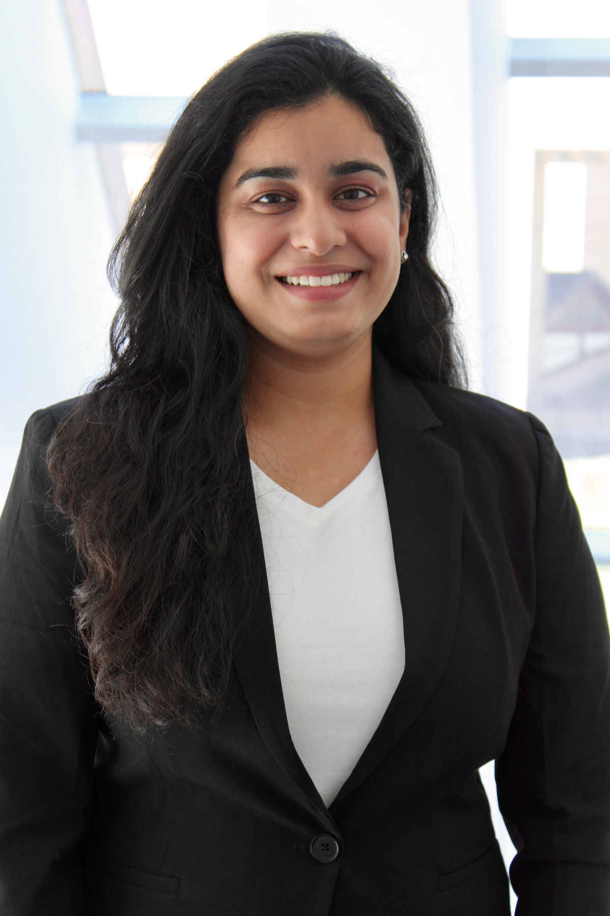

July 2024 – Dec 2024
MY INTERNSHIP JOURNEY
AT EOED
Anushree Chowdhary
Quality Assurance IT Intern
Notes:
Amazing

Slide 2
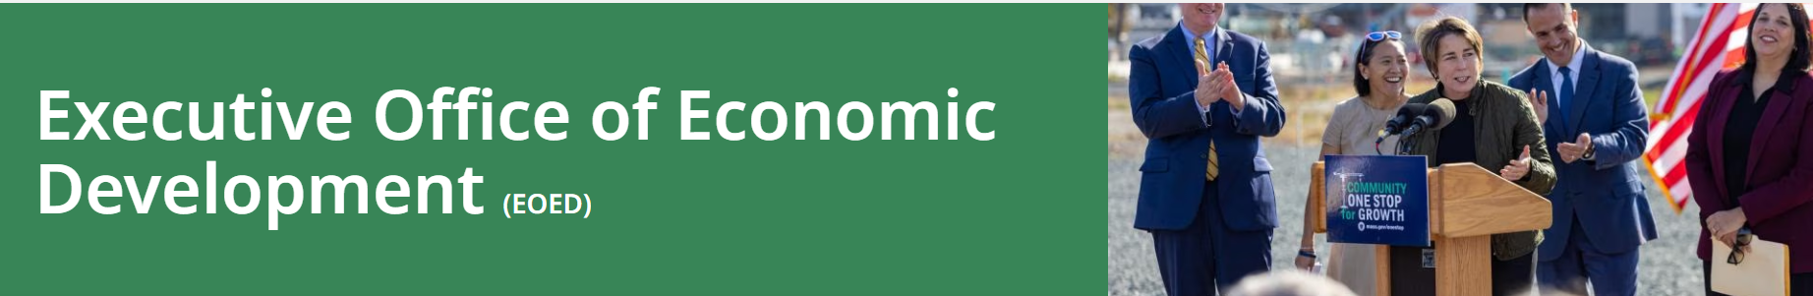
01
Introduction
02
About the Team
Contents
03
Project Overview
04
Tools and Technology
05
Office Activities and Mingling
06
What I learned & Future Goals
07
Acknowledgments

Slide 3

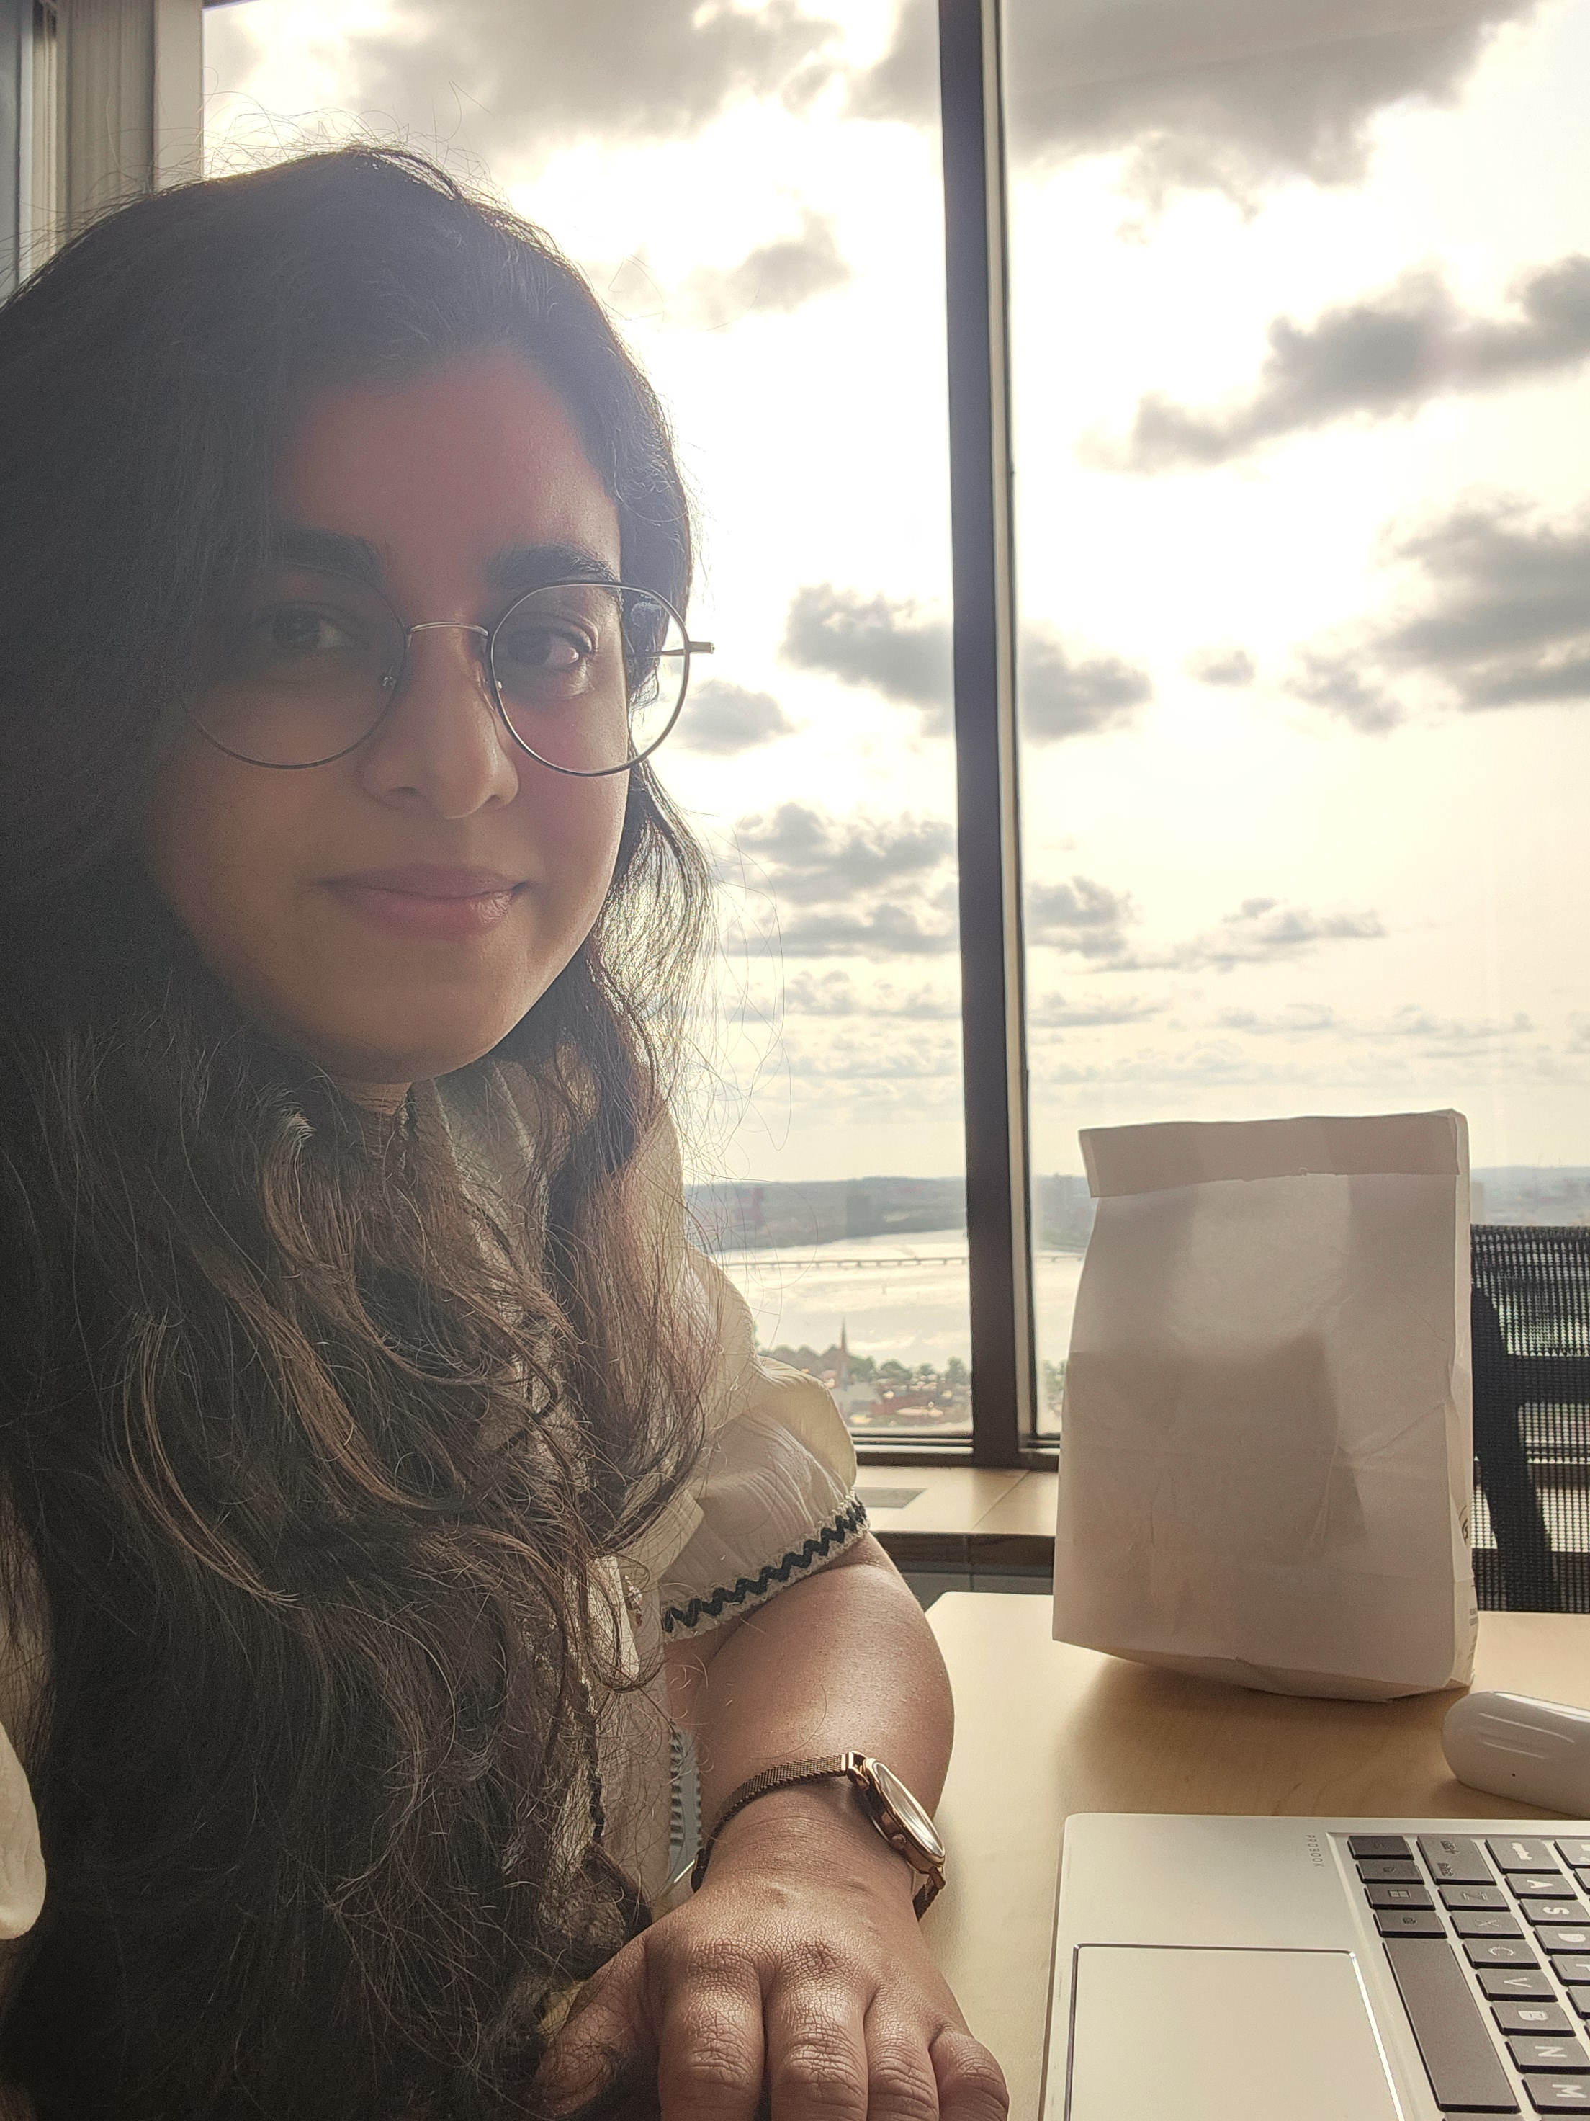
INTRODUCTION : The Business Analyst in the Making
👩‍🎓 Graduate Extraordinaire
Graduating Today i.e. 18th Dec with a Master's Degree in Business Analytics from the University of Massachusetts, Isenberg School of Management! 🎓
Co-op at EOED as a Quality Assurance IT Intern.
Mastering the art of testing, debugging, and quality-checking with a side of caffeine! ☕
💻 Current Superpower

Slide 4

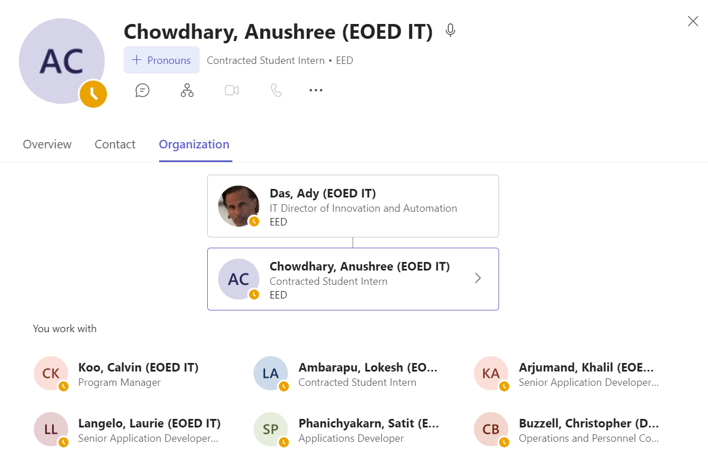

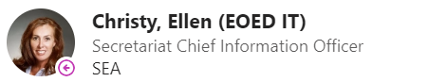

My Team ! The Amazing Superheroes Behind the Scenes
"They say a team is only as strong as its weakest member... but with this team, I can confidently say we have no weak links – only strong coffee and infinite patience!"
01
The Code Warriors
02
The Feedback Ninjas
03
Problem Solving Gurus
04
The Support Squad

Slide 5
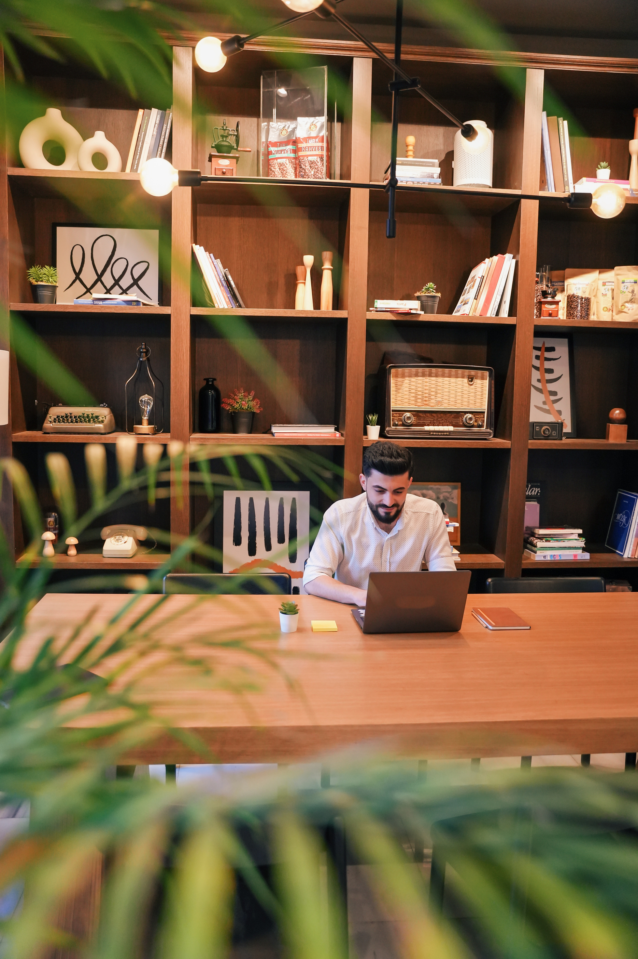
1
RMS Upgrade
2
Lemon Law App
The Quest for Knowledge: My Project Adventures
3
FT Agent Process
Current Project:
NMLS Upgrade Project
4
BFD UAT Testing
5
OARS Upgrade

Slide 6

Projects

Slide 7

Project Highlights & My Legendary Contributions
RMS Upgrade Project
OARS Fronted Backend Processes
BFD UAT Testing
Objective: The RMS Windows Server 2012 upgrade plan aimed to migrate the system to Windows Server 2022. My role involved supporting the testing of the upgraded version of RMS to ensure a smooth transition.
Tasks: Conducted both manual and automated testing on the RMS application. Reported defects and tasks in JIRA to track progress. Identified security loopholes in the system, and played a key role in the remediation process to strengthen security.
Impact: Ensured the RMS upgrade was successfully completed without major issues, maintaining system stability throughout the process. Contributed to making the application more secure and robust, mitigating potential vulnerabilities and enhancing overall performance.
Learning: gaining hands-on experience with both manual and automated testing techniques, and developing a deeper understanding of security remediation to enhance application security, stability and robustness.
Objective: The objective was to perform comprehensive testing of the OARS application, focusing on the Admin Login and Institution Login functionalities, and to ensure the application’s data integrity and system reliability across key processes, including database refresh and address updates.
Tasks: Helped with the testing of the OARS application and documented the results.
Impact: Successful validation of Key functionalities, Raised awareness on a key issue.
Learning: Gained hands-on experience in validating complex login functionalities and database refresh processes, Enhanced understanding of issue identification and reporting in a collaborative environment.
Objective: The objective of the new centralized portal is to provide a single online access point for businesses to easily connect with state resources, ensuring streamlined support for their needs. The system will use AI and staff coordination to direct businesses to the right resources, enhancing responsiveness and engagement.
Tasks: Helped the team with UAT testing of this salesforce-based application
Impact: Ensure final project meets user experience, identify critical issues before launch and improves overall system usability and functionality.
Learning: Deepened the understanding of the BFD project and Learned to work in a team.

Slide 8
Project Highlights & My Legendary Contributions
FT Agent Process
Lemon Law App
NMLS Upgrade Project
Objective: Automating the process of putting FT Agent Licensee report in the Division’s Sharepoint Folder.
Tasks: Run a stored procedure to extract the list of licensee in Excel Zip format and upload it to the sharepoint location.
Impact: We as a team successfully implemented the process and now every Friday this process runs and updates the folder.
Learning: Learned to work as a team. Learned how to automate a process of extracting a table from SSMS by running a stored procedure and update it to the desired folder.
Objective: Migration of the Lemon Law application from AWS to Azure website (Microsoft stack). Focused on ensuring functionality and stability post-migration.
Tasks:
Testing: Validated app performance and functionality on Azure.
Issue Reporting: Documented bugs and tracked resolutions via JIRA.
Impact: Ensured a smooth transition to Azure with minimal disruptions.
Improved application stability, scalability, and security.
Learning: Gained understanding of Massachusetts Lemon Law and its consumer protections.
Developed collaboration skills and learned to align technical work with business requirements.
Objective: Automated NMLS support process that dev team manually do it daily in the morning which is time consuming.
Tasks:
Impact:
Learning:
Current Project
Notes:
Testing the notes

Slide 9


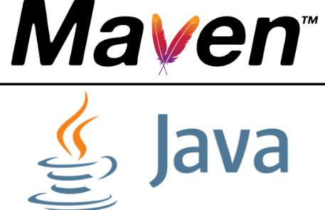
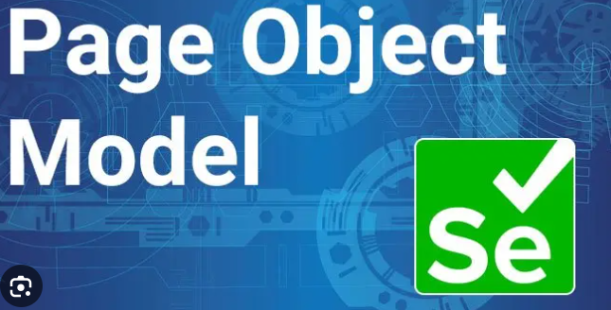
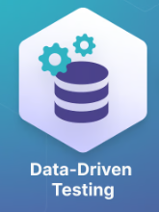
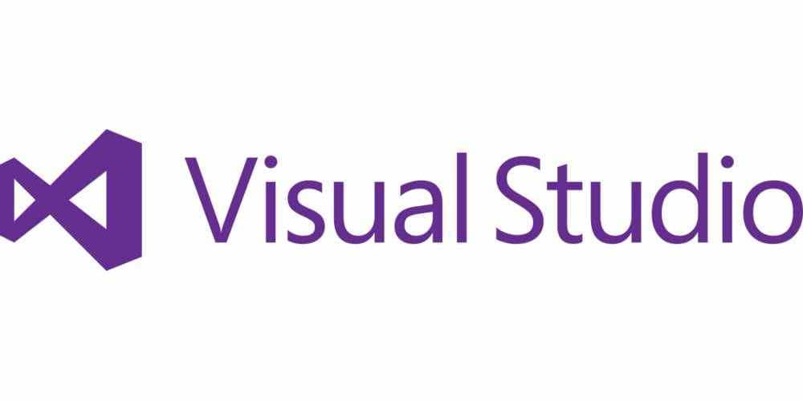





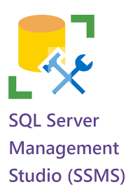
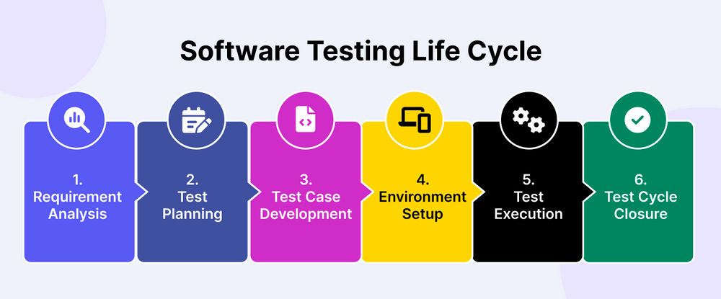
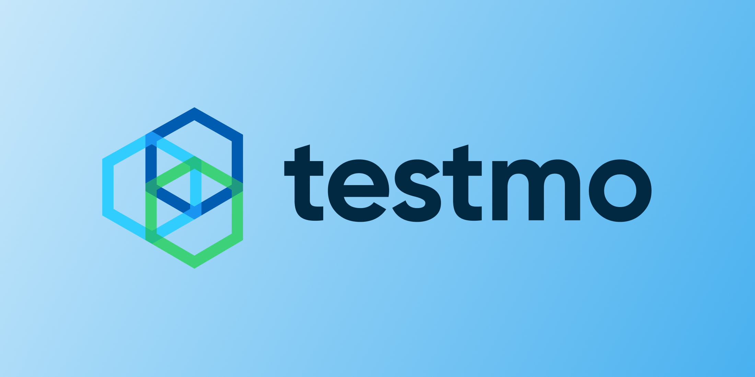
Target Audience

Slide 10
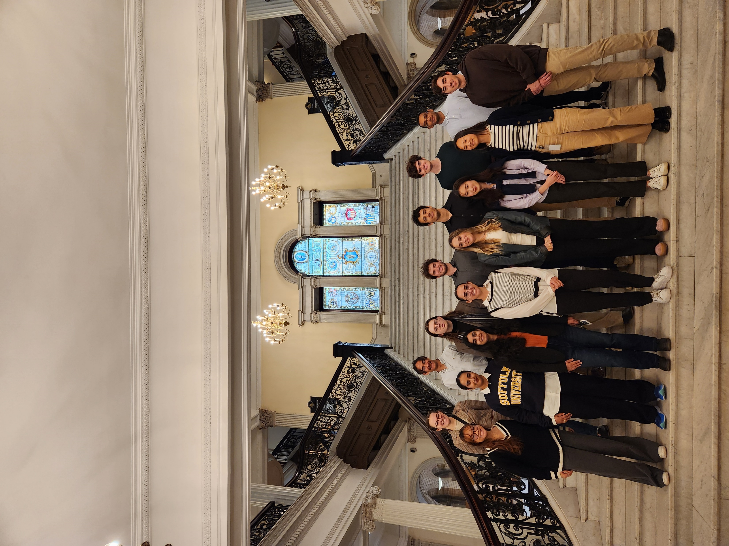

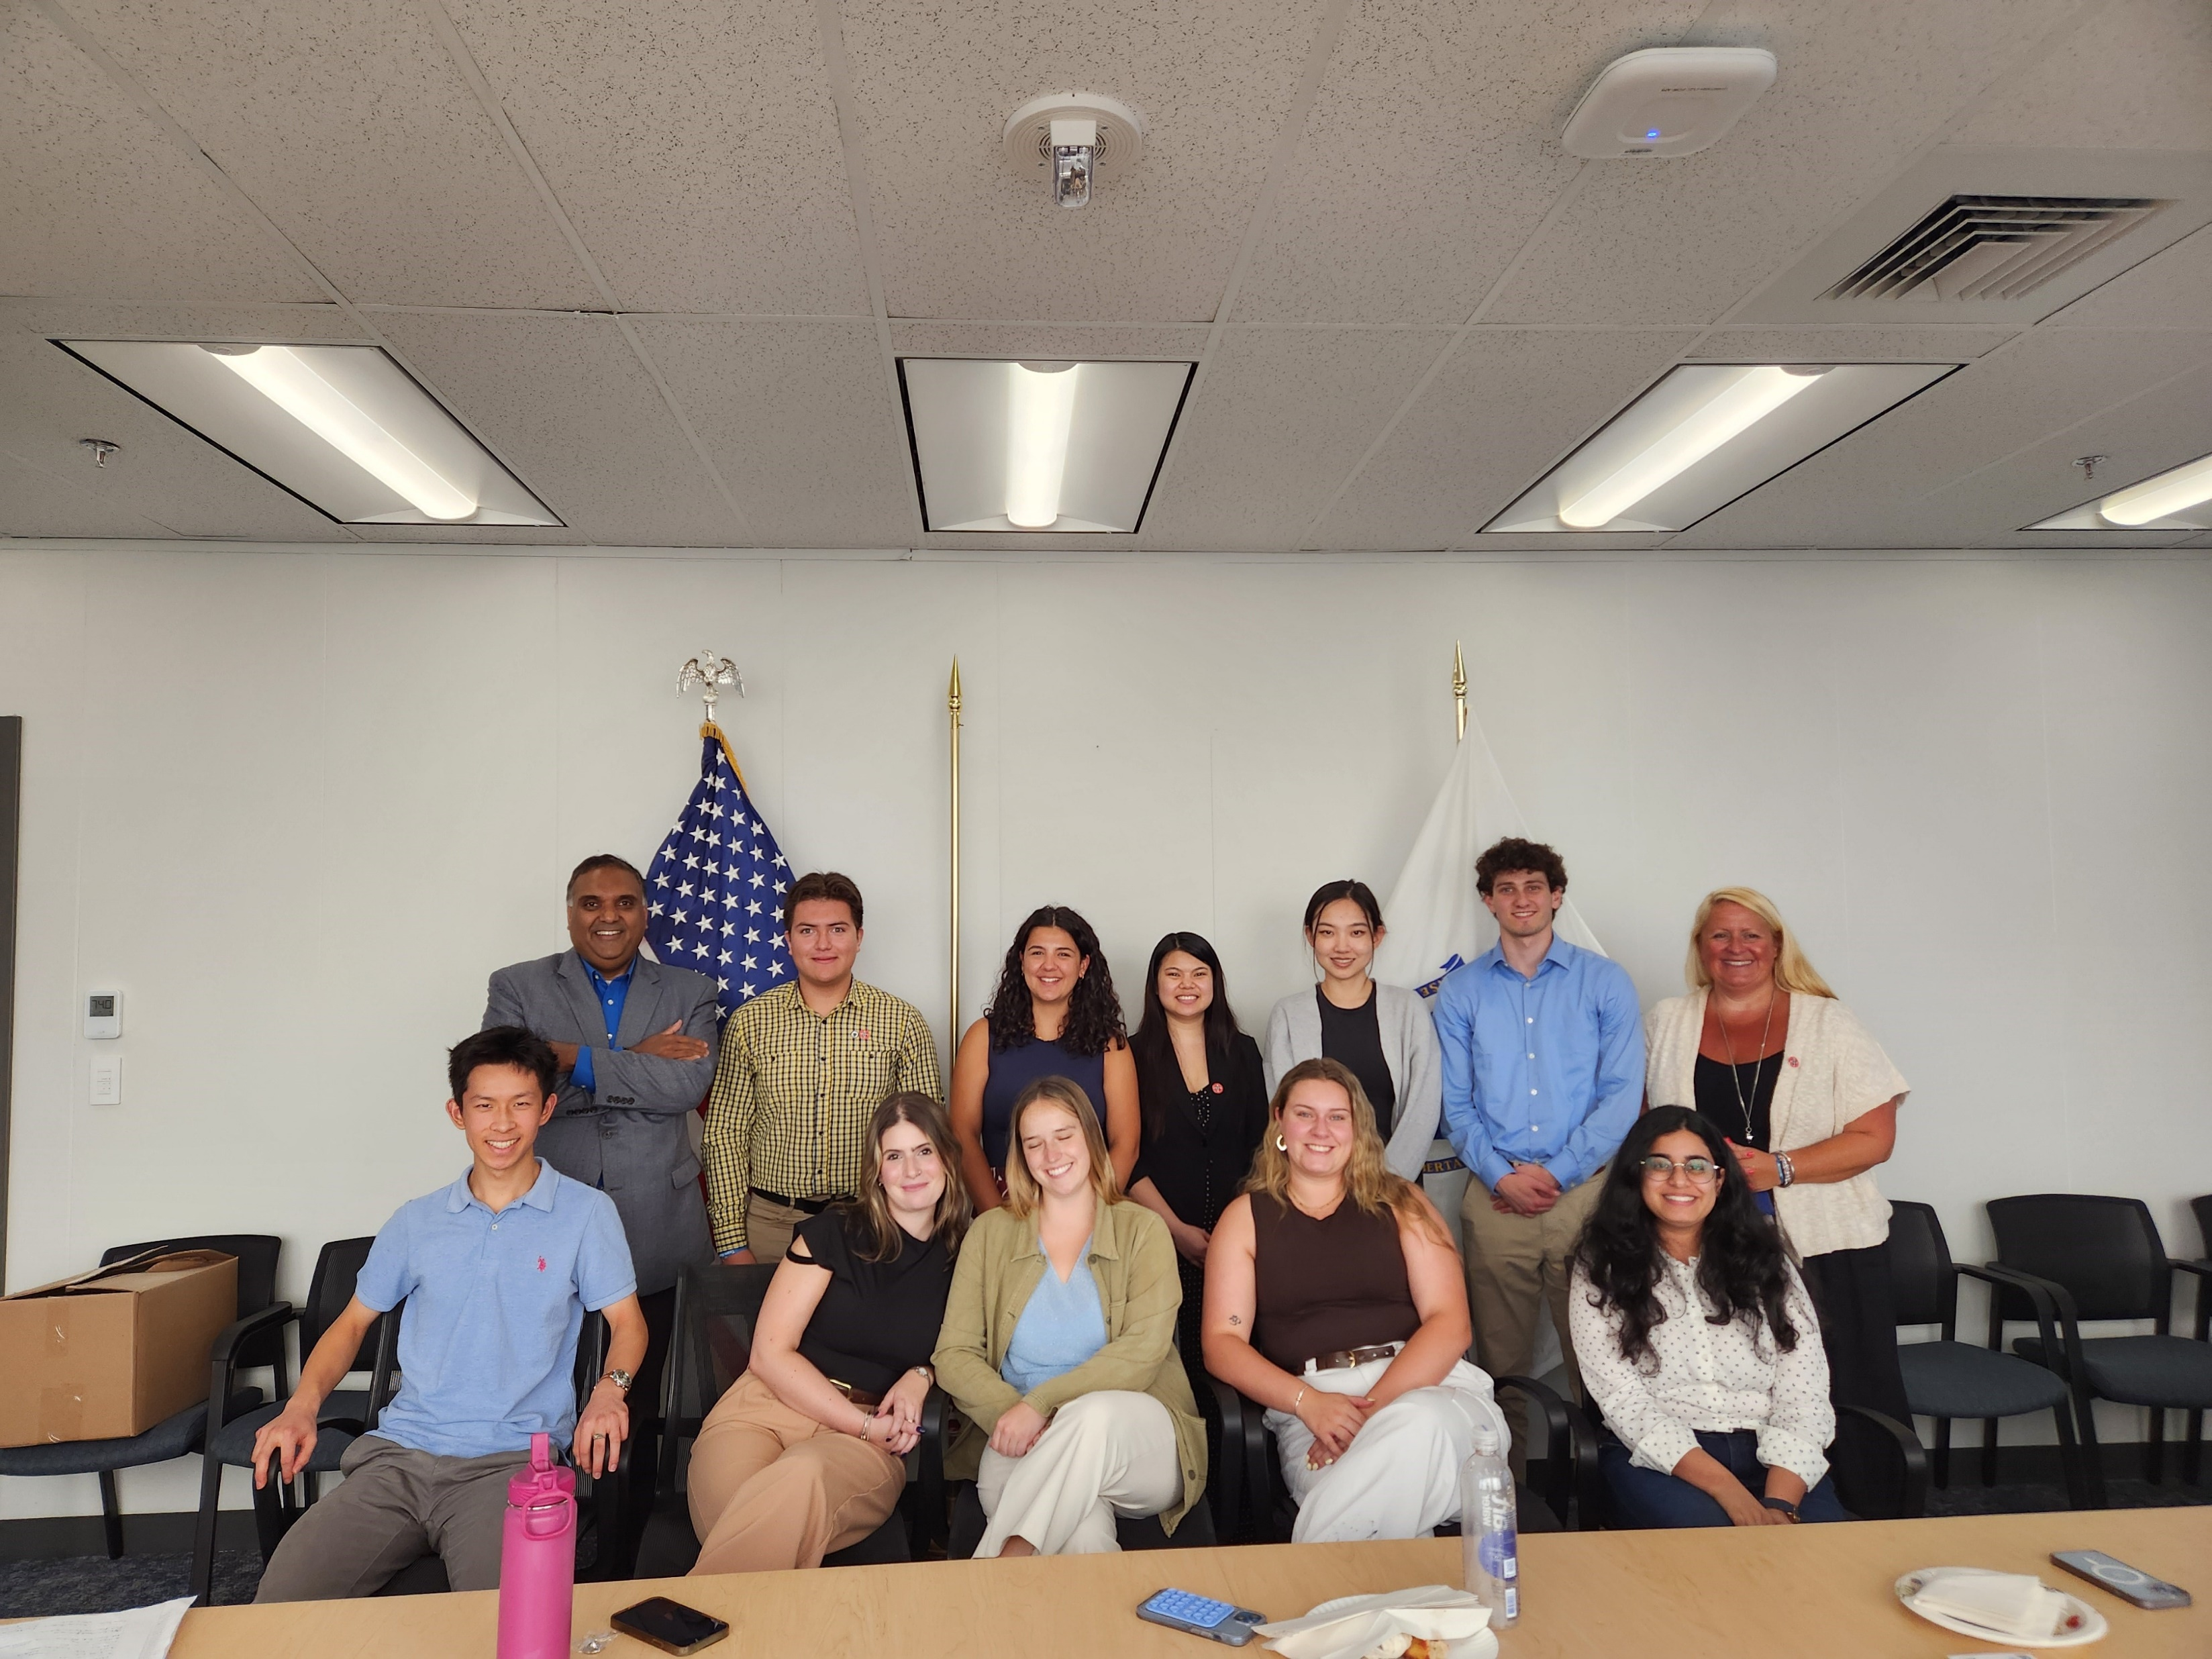
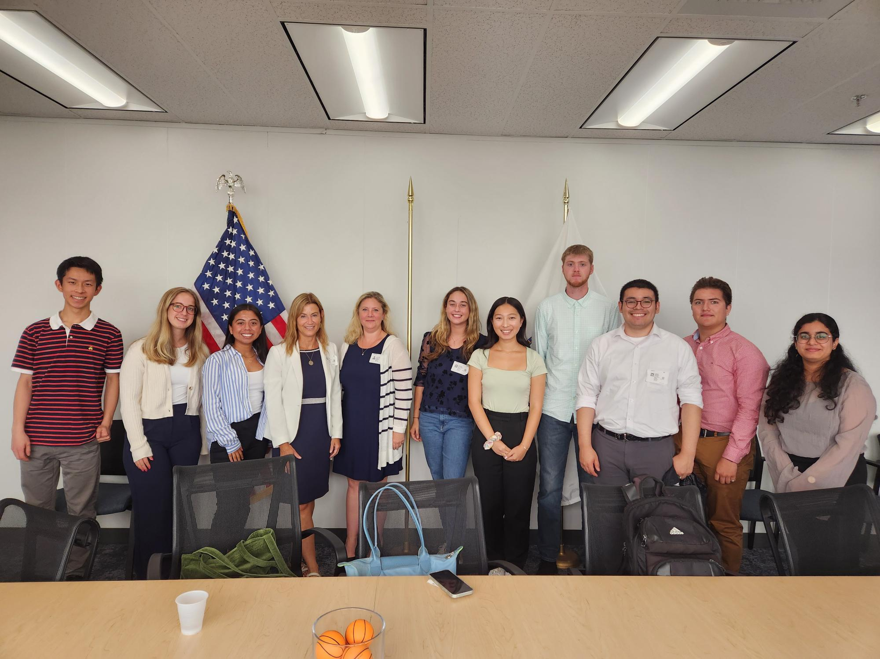
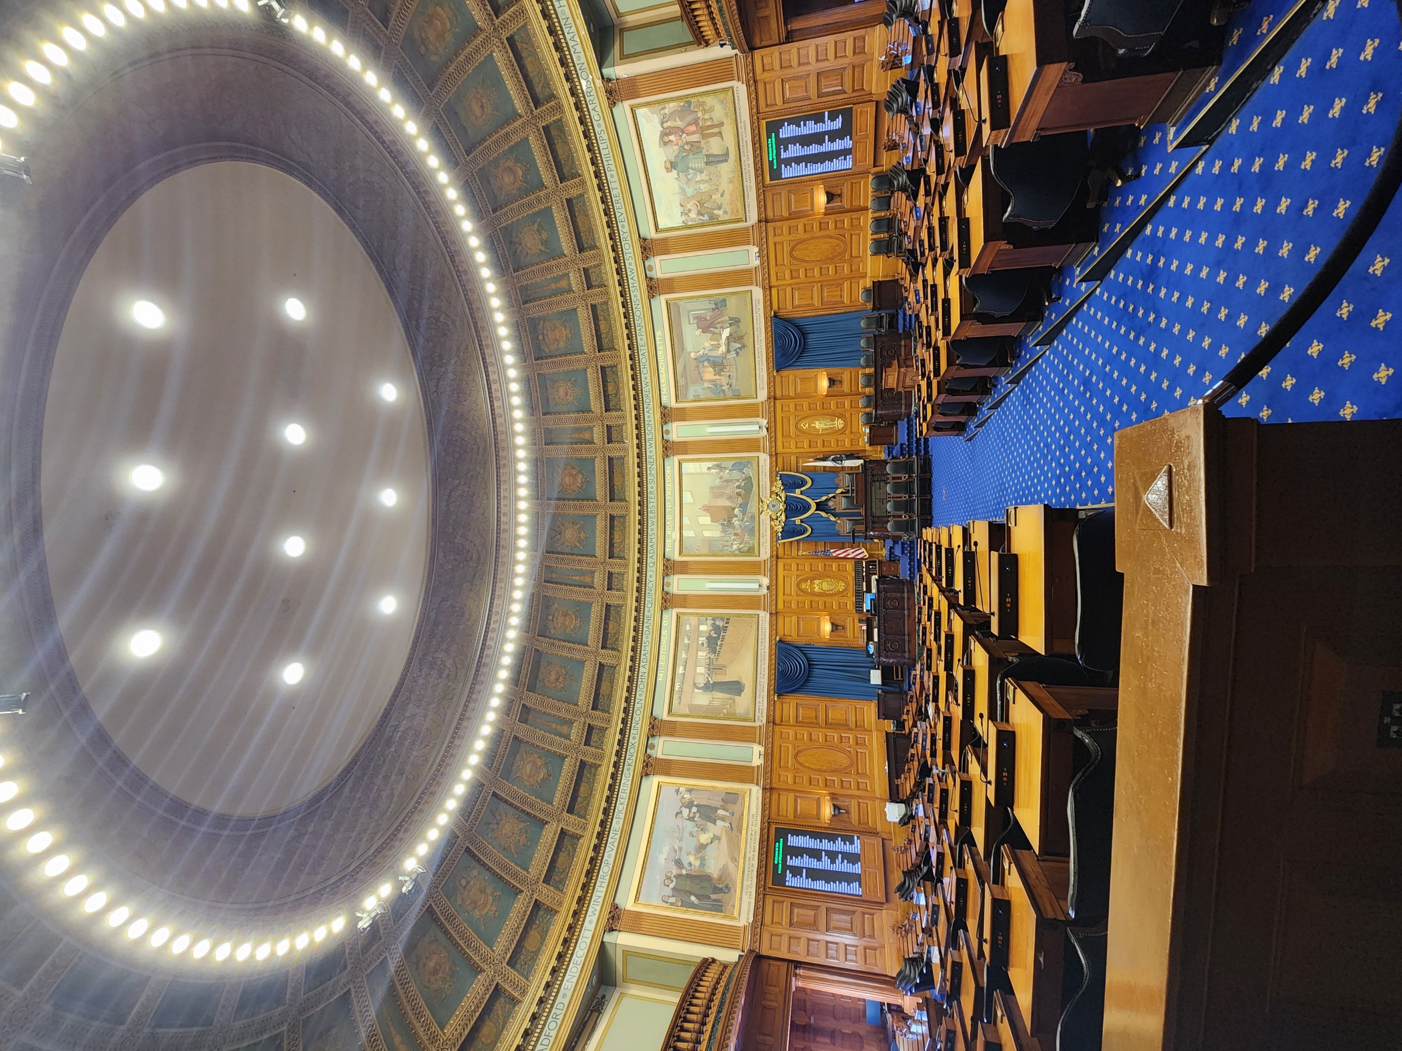
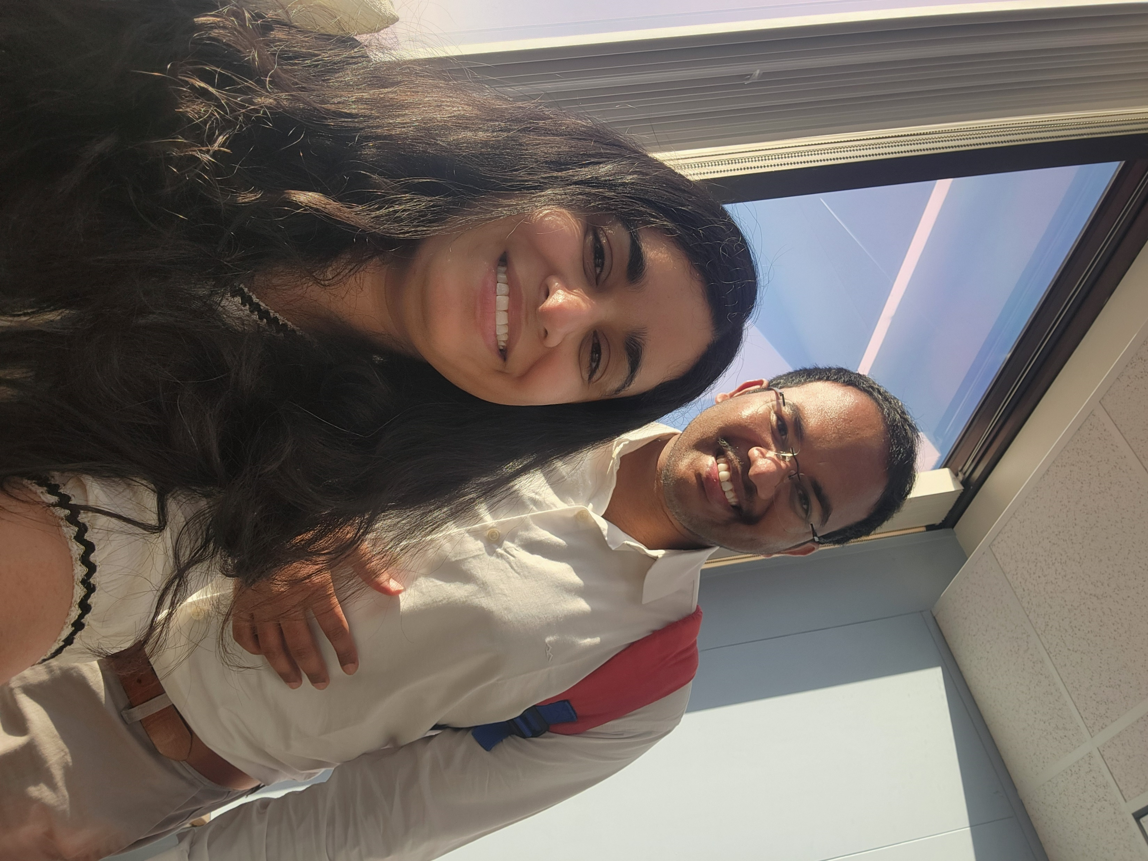
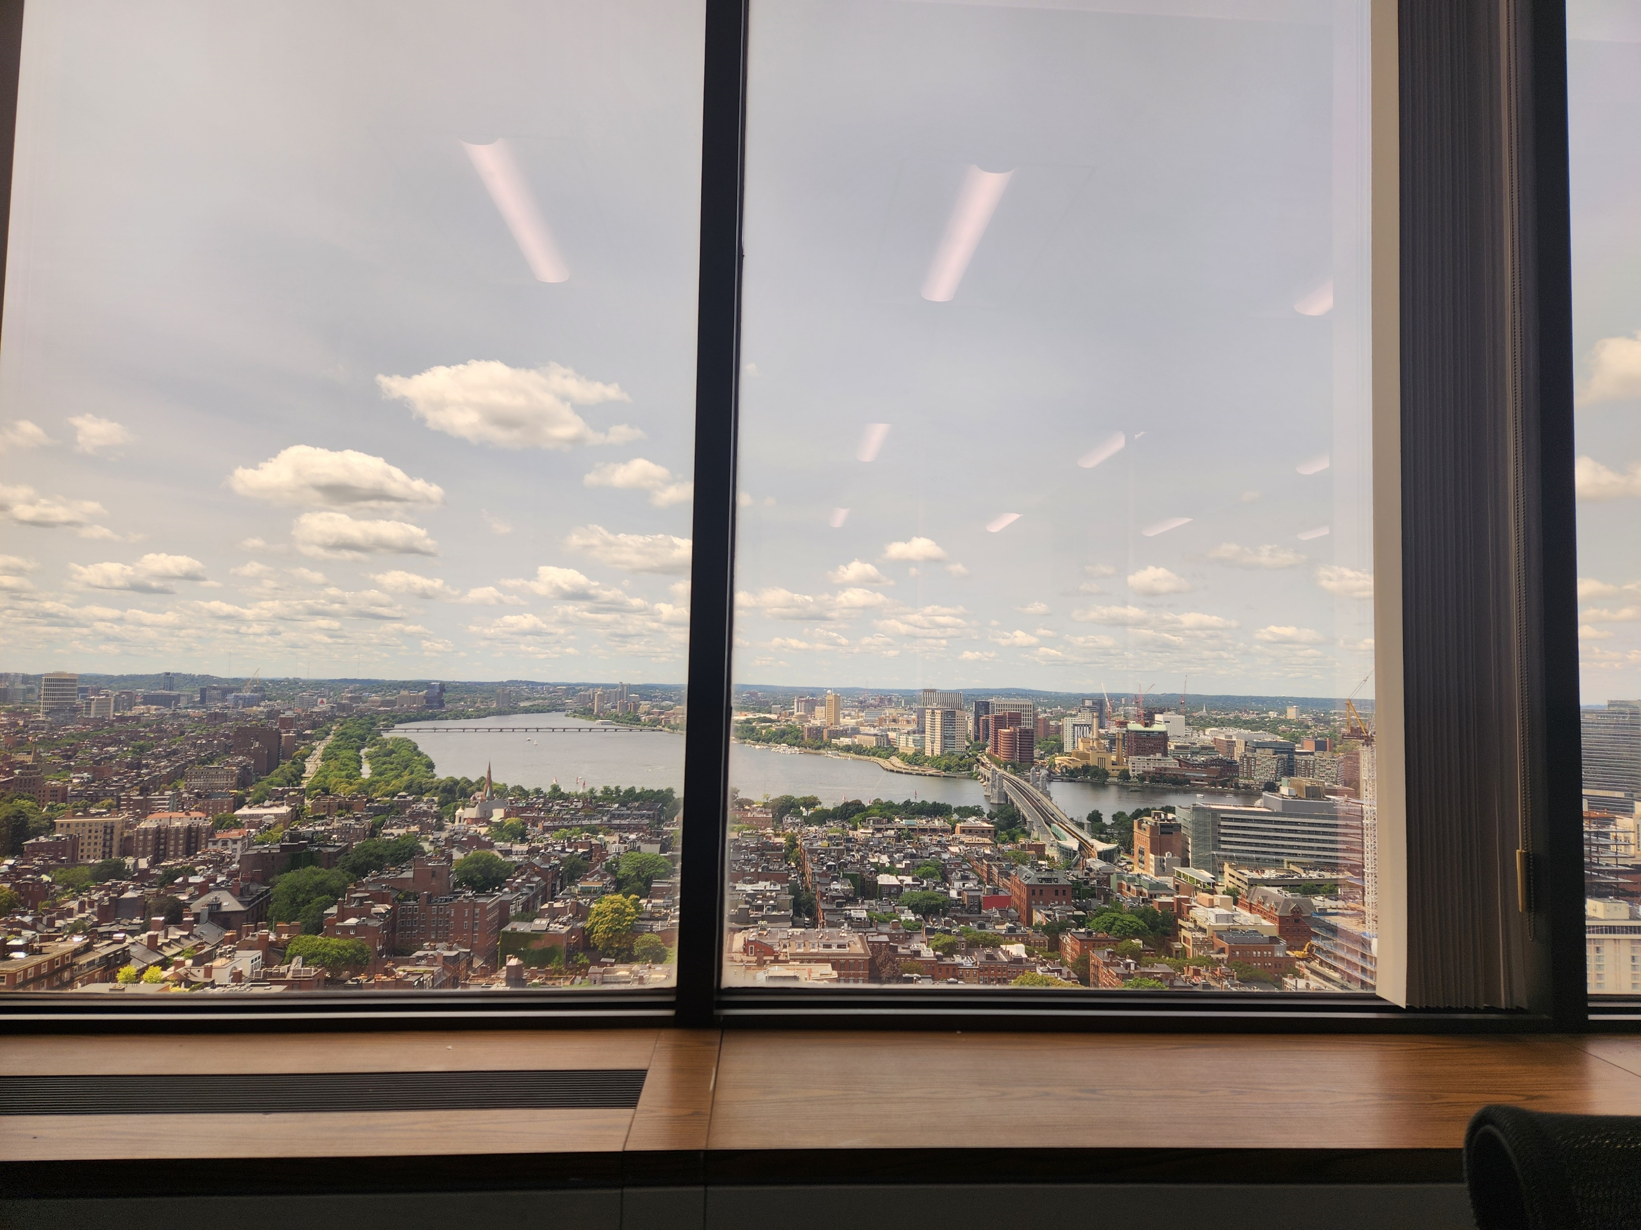
Office Activities:
01
Lunch and Learns
02
In person Quarterly meet
03
State House Tour

Slide 11




Takeaways
Future Goals
People and Culture make you
Come back to EOED and continue to work on NMLS upgrade project and many other exciting project.
You can do (learn) anything !
Contributing to the Big Picture
Graduate in December 2024

Slide 12
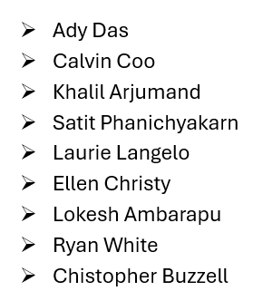
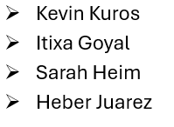
Acknowledgments and Thanks:

Slide 13

Thankyou!!

